Slide 1


Slide 2

Introduction
ContractNest's human resources system was created to grant organizations the possibility to manage employees, watch current employee status in the company, keep track on bookings and let the external employers the ability to book different kinds of services. Our team, will meet your requirements and known processes in your own organization all to offer you the optimal solution for your company.
- Defining the requirements by adjusting to the clients needs.
Beginning the product development process.
Databases which is the core of the product.
Product users.
Existing features in the product.
The software concentrates on the human resource company's ability to run its database in a convenient way.

Slide 3
Team Members
Nika Tatikishvili : ID: 321735433, Phone Number: 0535309655.
Noa Fadida – ID: 209507680, Phone Number: 0525606988
Ofek Elgozi - ID: 318432085, Phone Number: 0507308020
Otir Mesilati – ID: 206317181, Phone Number: 0542170590
Adi Godosi - ID:316413780, Phone Number: 0522653087
Eilon Vana - ID:316531581, Phone Number: 0546630092

Slide 4
Main Requirements
Login
Search
Edit/View Contractor Information
Booking
Salary Calculation
Report Hours
Add New Contractor
External Employee Register

Slide 5
Added Functions
Beside the initial requested functions, we were asked to develop, we also had to add our own features to the software.
We have improved and extended the contractor’s salary calculation feature and enabled them to view any salary calculation from any month and year instead of just the current month.
We also enabled the company employ to enter the contractor information and search for contractors not only by name but with city, hourly pay, profession, attendance clock as well.

Slide 6
Use Case
Through the use case we gathered and analyzed the functionality of our system.
this use case is describing how our system communicates with the users.
The actors in our use case scenario are our end users which are defined as the product users, and its easily understandable for our users.
Use case actors: Company employees, contractors and external employees.

Slide 7
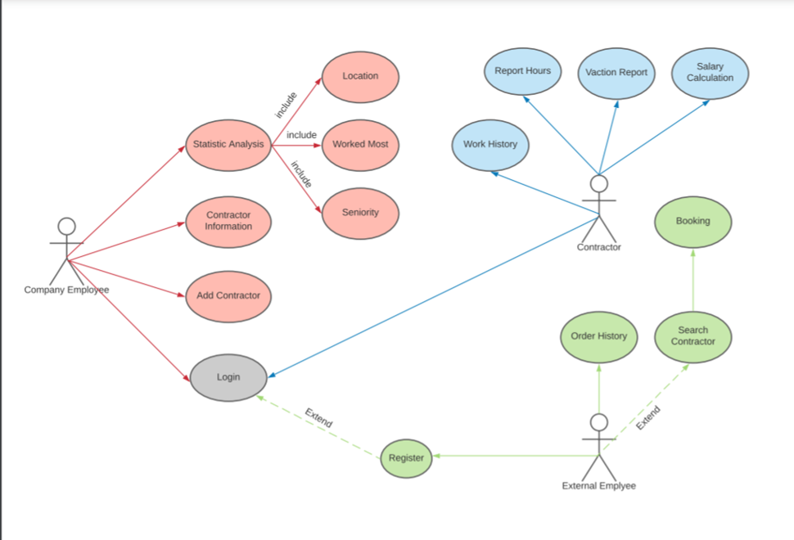

Slide 8
DFD
DFD: A Data Flow Diagram is a traditional way to visualize the information flows within a system.
This picture described DFD-0 that contains the most important processes of the system
DFD-1 exists for these processes: Analyze Statistics, Log In, Search.
DFD-2 exists for Search.

Slide 9
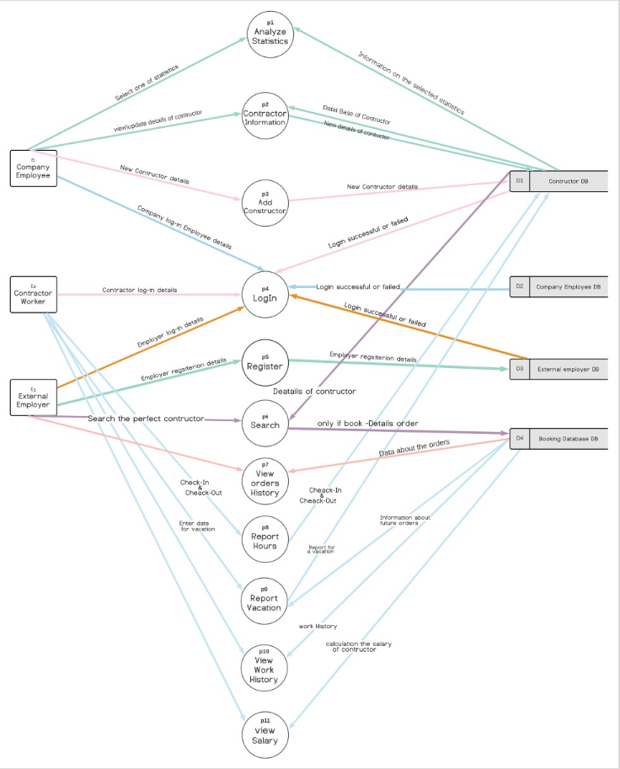

Slide 10
Software Test Plan
ContractNest’s testing method is functional testing used by the developers of the software.
We did find a few bugs:
In the employee menu if you chose an unspecified number the software closes instead of asking for input again.
In the company employee city statistics incorrect information is displayed
In report hours function when providing 0 premium minutes the user is asked for hours instead of minutes
When editing contractor’s information while entering invalid input, the software tries to edit information of a contractor which does not exist.

Slide 11
Process challenges
First group project.
New people with different opinions.
It is difficult to combine with other courses.
Topics we had to study on our own.
Following the deadlines.

